Slide 1
EECE 6690 Final Project
A Public Domain Datasheet for Human Activity Recognition Using Smartphones
By Ronan McNally and Stefan Pancari

Slide 2
Paper Introduction
Paper Selected: “A Public Domain Datasheet for Human Activity Recognition Using Smartphones” By Anguita et al. [1]
Use smartphone as a sensor for Human Activity Recognition (HAR)
Detect human body motion using a smartphone to gather information about individual's movements
Measured with 3-axial smartphone accelerometer and gyroscope sensor
Proved smartphones can effectively detect and distinguish activities such as:
Walking
Walking Upstairs
Walking Downstairs
Sitting
Standing
Laying
Used One-versus-all Gaussian support vector machine (SVM) do distinguish these activities with an accuracy of 96%
Dedicated HAR sensors fall in the range of 90-96% accuracy [1]
EECS 6690 Final Project Presentation

Slide 3
Dataset Introduction
Dataset created by Anguita et al. [1] from working with 30 volunteers performing the six activities
Data from accelerometer and gyroscope was processed, normalized, and filtered
In a time window the measured ten parameters:
For each parameter(x,y,z), 17 statistical values calculated (mean. std, mad, max, min,…,angle)
Total collection of 562 features
Data split 70% training and 30% testing
Body Acceleration | Body Acceleration Magnitude
Gravity Acceleration | Gravity Acceleration Magnitude
Body Acceleration Jerk | Body Acceleration Jerk Magnitude
Body Angular Speed | Body Angular Speed Magnitude
Body Angular Acceleration | Body Angular Acceleration Magnitude
EECS 6690 Final Project Presentation

Slide 4

Paper Replication Process
Import Dataset into RStudio
Support Vector Machine Hyperparameter Tuning
One-versus-all Support Vector Machine
Build Confusion Matrix
EECS 6690 Final Project Presentation

Slide 5
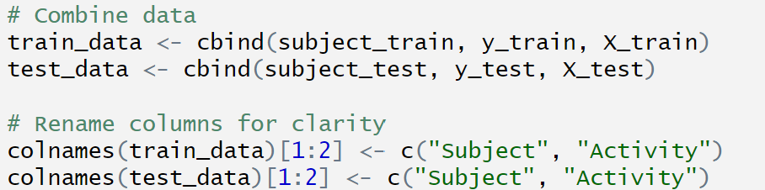
Import Dataset Into Rstudio
Data was provided in separate text files
Necessary to combine data into training and testing data sets:
subject_train/subject_test -> the individual that produced the data
X_train/X_test → the data collected from each individual
y_train/y_test → the activity the individual performed
Extract the activity column
Needed for SVM creation
EECS 6690 Final Project Presentation

Slide 6
Support Vector Machine Hyperparameter Tuning
Desire to find optima hyperparameters for Gaussian SVM:
Gamma → influence of a single training point on the decision boundary [2]
Cost → specify the cost of a violation to the margin [3]
Can be implemented using:
Grid Search
Random Search
Bayesian Optimization
Method used is Bayesian Optimization with bayesOpt() in library(ParBayesianOptimization)
Steps:
Define SVM Scoring function
Input: Gamma and Cost from bounds
Output: Accuracy
Define gamma and cost bounds
Perform Bayesian Optimization
Repeated until numbers converge
Results:
Optimal Gamma = 0.00218813
Optimal Cost = 11.51105
EECS 6690 Final Project Presentation

Slide 7
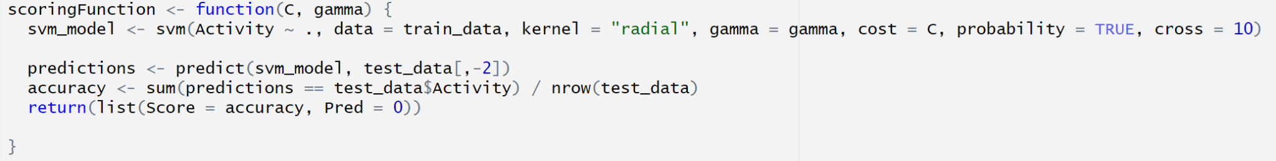
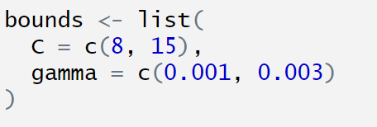
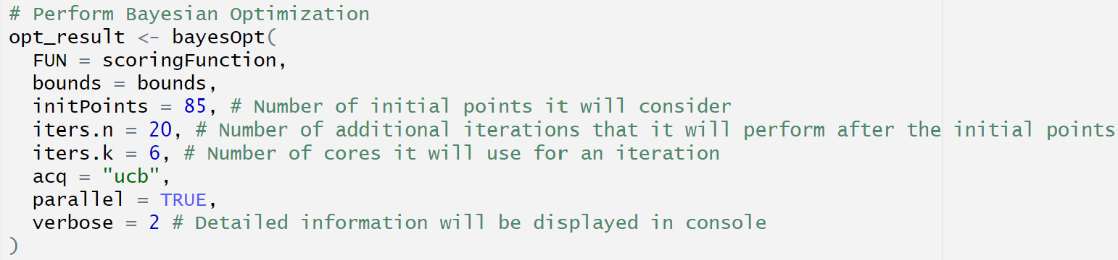
Support Vector Machine Hyperparameter Tuning
SVM Scoring Function
Cost and Gamma Bounds
Bayes Optimum Function
EECS 6690 Final Project Presentation

Slide 8
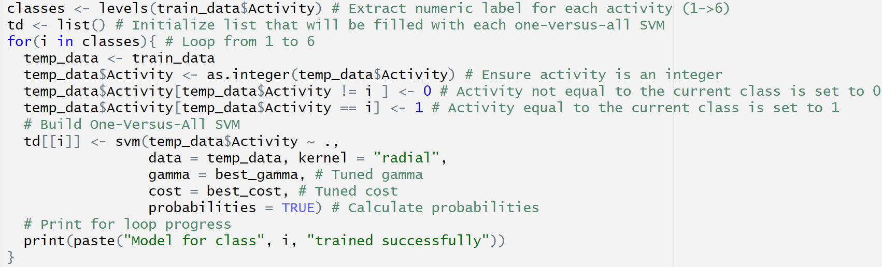
One-Versus-All Support Vector Machine
With optimal hyperparameters, one-versus-all support vector machines were built using training data
One-versus all separates one human activity from the rest
Example:
Draw hyperplane to separate walking from walking upstairs, walking downstairs, sitting, standing, and laying
Process repeated for each activity
EECS 6690 Final Project Presentation

Slide 9
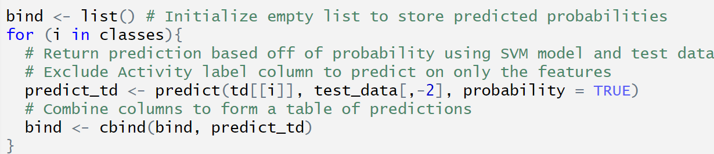
Build Confusion Matrix
First use predict() function to calculate the probability of the test data belonging to each one-versus-all SVM
Shows how confident the model is on unseen data
Bind the predictions by column into a table
Search each row in binded prediction table (step 1.b) to select the activity with the highest probability for each observation
This is predicted data
Create confusion matrix table to compare true data with predicted data in step 2
Calculate the:
Precision → Percent of predictions that are correct
Recall → Percent of relevant data points that were correctly identified
Overall Accuracy → Accuracy of the SVM model
Step (1): predict on test data
EECS 6690 Final Project Presentation

Slide 10
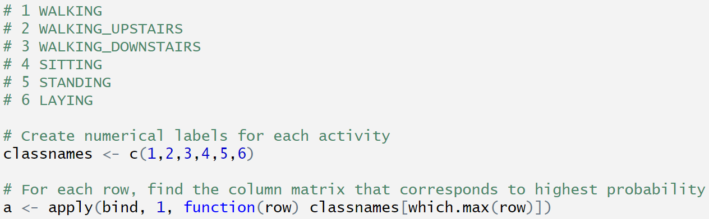
Build Confusion Matrix
Step (2): Select activity with highest probability for each observation
Step (3): Create confusion matrix
Step (4): Calculate Results
EECS 6690 Final Project Presentation

Slide 11
Our Confusion Matrix Results
Predicted
 | WK | WU | WD | ST | SD | LD | Recall
Walking | 487 | 2 | 7 | 0 | 0 | 0 | 98.19%
W. Upstairs | 13 | 457 | 1 | 0 | 0 | 0 | 97.02%
W. Downstairs | 2 | 16 | 402 | 0 | 0 | 0 | 95.71%
Sitting | 0 | 1 | 0 | 444 | 44 | 2 | 90.43%
Standing | 0 | 0 | 0 | 14 | 518 | 0 | 97.37%
Laying Down | 0 | 0 | 0 | 0 | 16 | 512 | 97.02%
Precision | 97.01% | 96.00% | 98.05% | 96.94% | 89.62% | 99.62% | 95.96%
True
EECS 6690 Final Project Presentation

Slide 12
Anguita et al. Confusion Matrix Results
Predicted
 | WK | WU | WD | ST | SD | LD | Recall
Walking | 492 | 1 | 3 | 0 | 0 | 0 | 99%
W. Upstairs | 18 | 451 | 2 | 0 | 0 | 0 | 96%
W. Downstairs | 4 | 6 | 410 | 0 | 0 | 0 | 98%
Sitting | 0 | 2 | 0 | 432 | 57 | 0 | 88%
Standing | 0 | 0 | 0 | 14 | 518 | 0 | 97%
Laying Down | 0 | 0 | 0 | 0 | 0 | 537 | 100%
Precision | 96% | 98% | 99% | 97% | 90% | 100% | 96%
True
[1]
EECS 6690 Final Project Presentation

Slide 13
Trying something new…
Decision Trees
EECS 6690 Final Project Presentation

Slide 14
Why Decision Tree(s)?
A Non-linear Problem
Multi-class Classification
Visualization and Interpretability
Standing and lying down will have static accelerations across axis)
Walking is oscillatory
Magnitude vs components
Frequency vs time
(Hence radial kernel in paper)
SVMs are inherently binary classifiers (as seen by OVR and OVA), could be suboptimal compared to ensemble tree methods that can account for multiple classes without added manipulation
SVMs with a nonlinear kernel in 3D+ are “black boxes”
Decision trees enable one to view decision process
EECS 6690 Final Project Presentation

Slide 15
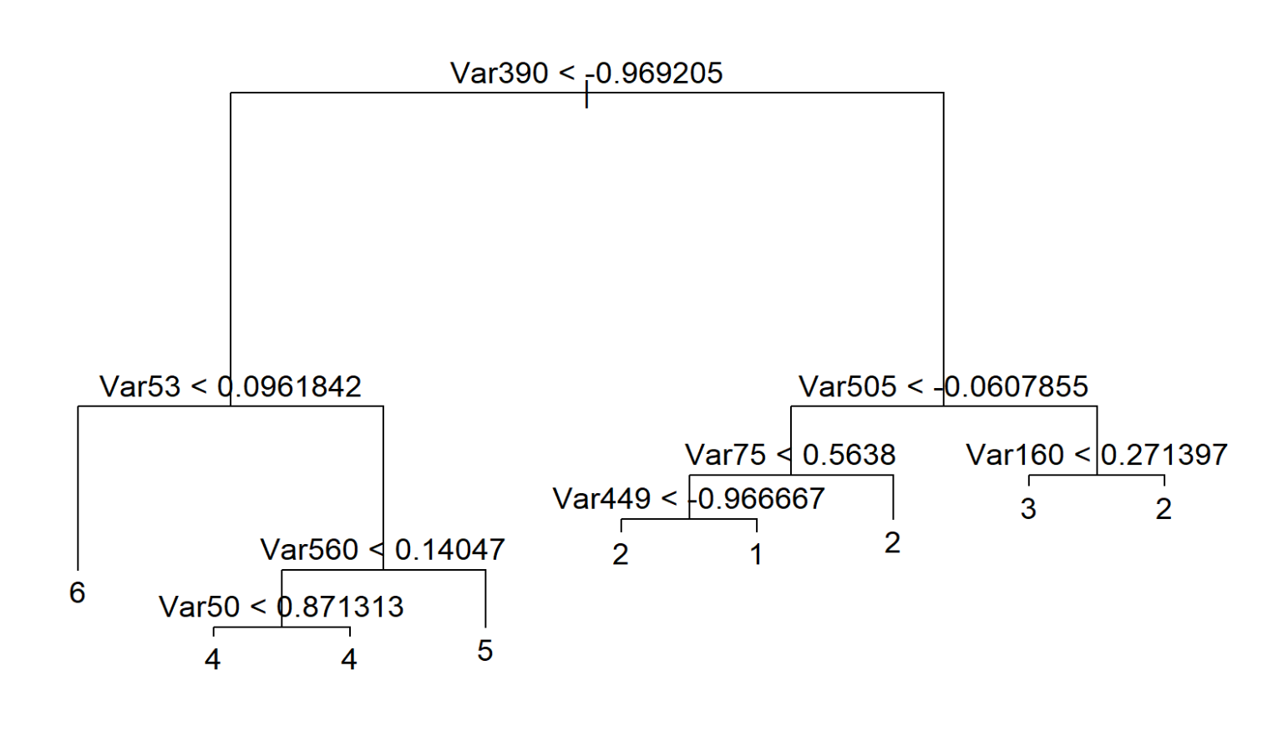
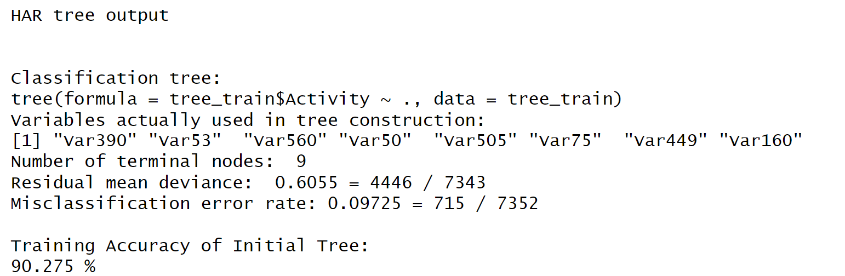
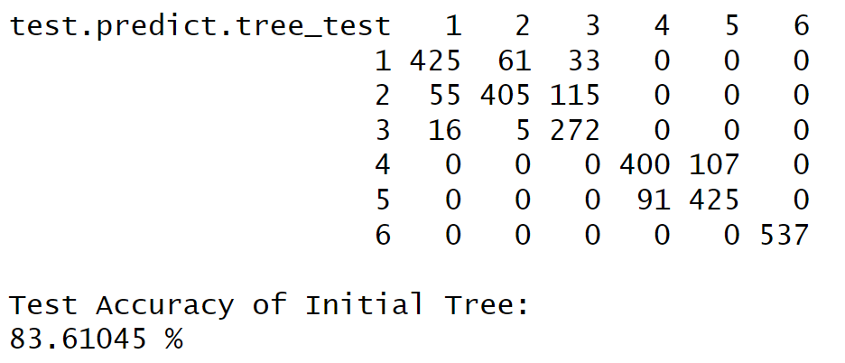
A Starting Point: Initial Decision Tree
Worse Performance:
Single trees are susceptible to overfit
→ pruning?
Outlier influence and difficulty traversing 562 features
→ ensemble tree methods?
Not horrible, but worse…
EECS 6690 Final Project Presentation

Slide 16
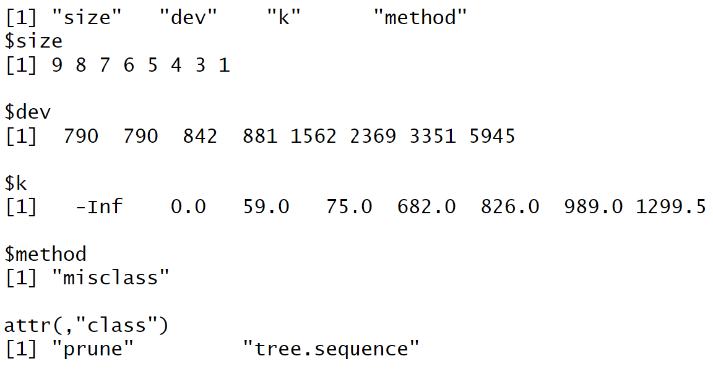
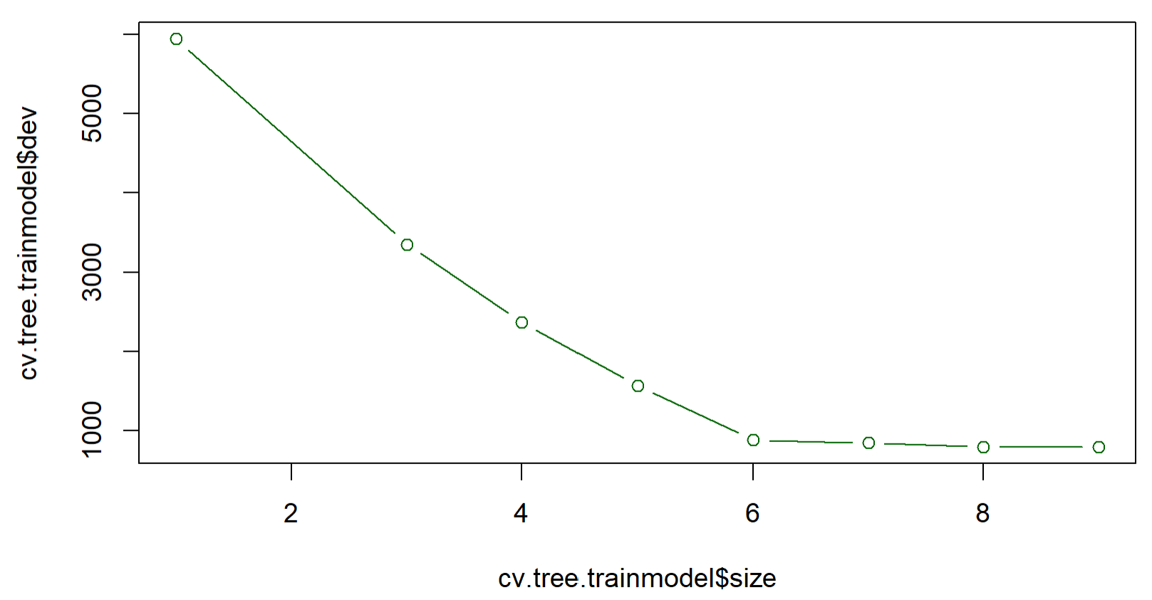
Effectiveness of Pruning?
Not effective
Any amount of pruning increased deviance!
Deviance
Tree Size
EECS 6690 Final Project Presentation

Slide 17
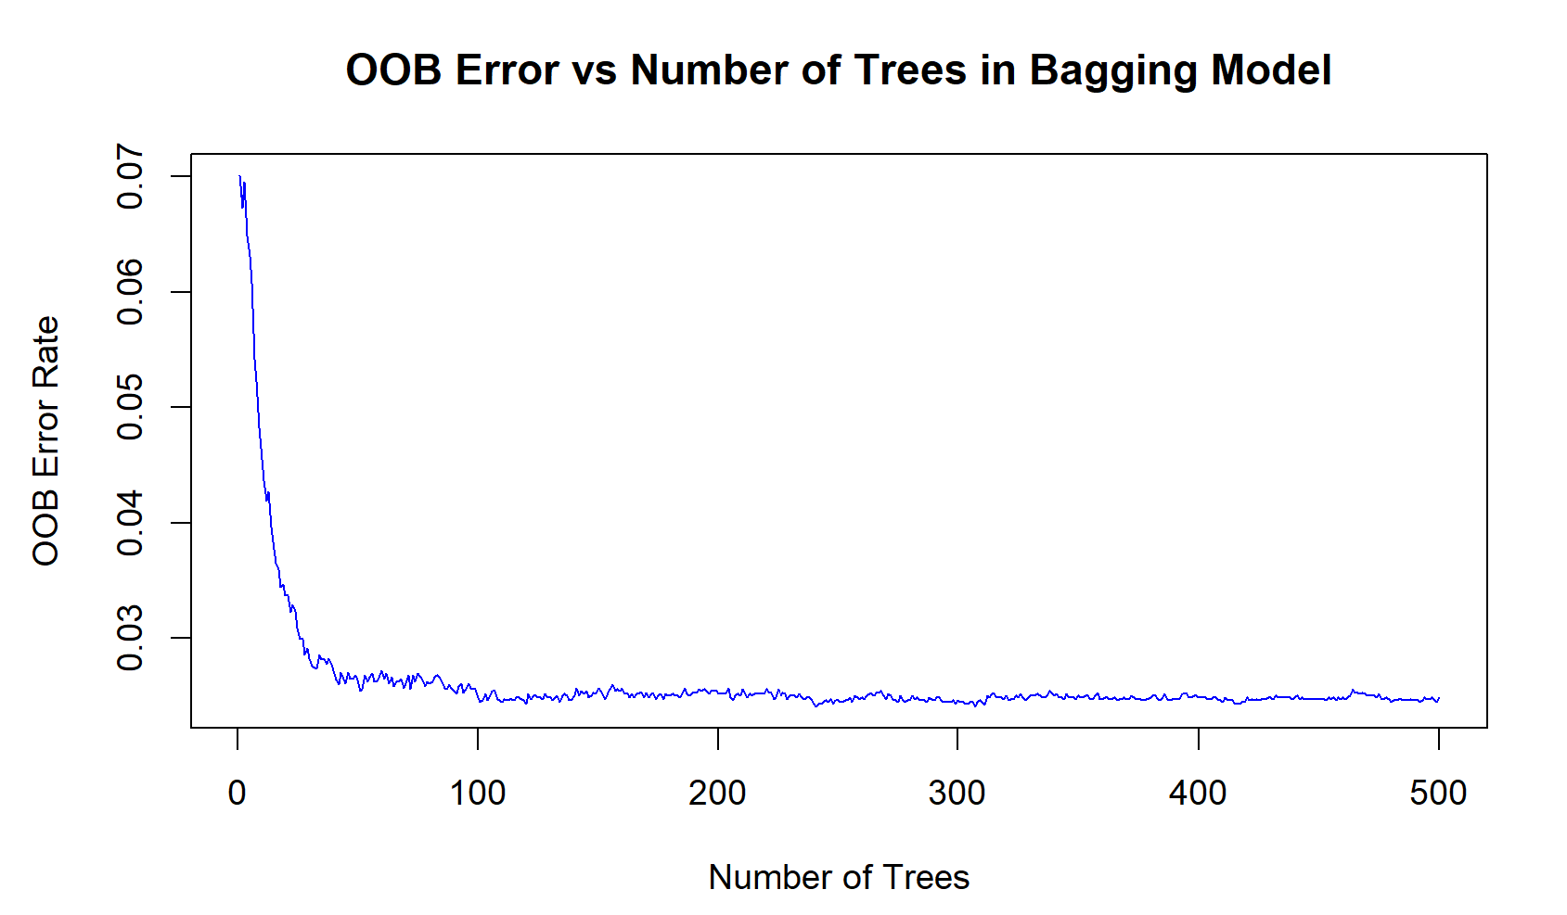
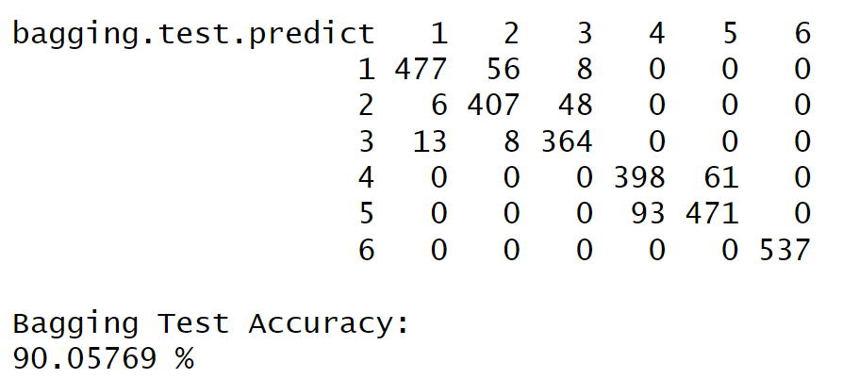
Bagging Method
Accuracy is comparable to other special purpose HAR sensors (90-96% range) as mentioned in paper [1]
Improve test performance via Random Forest
EECS 6690 Final Project Presentation

Slide 18
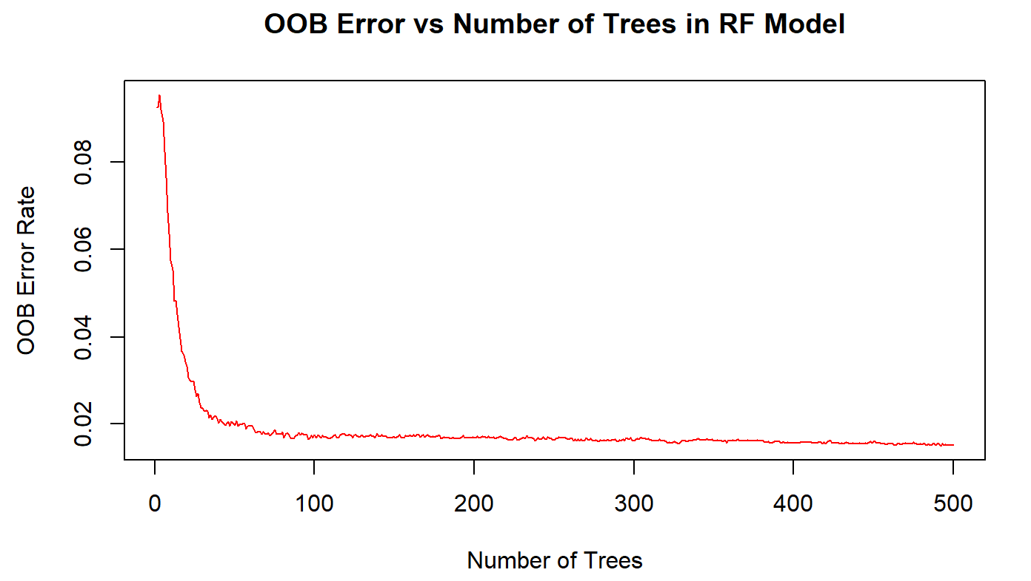
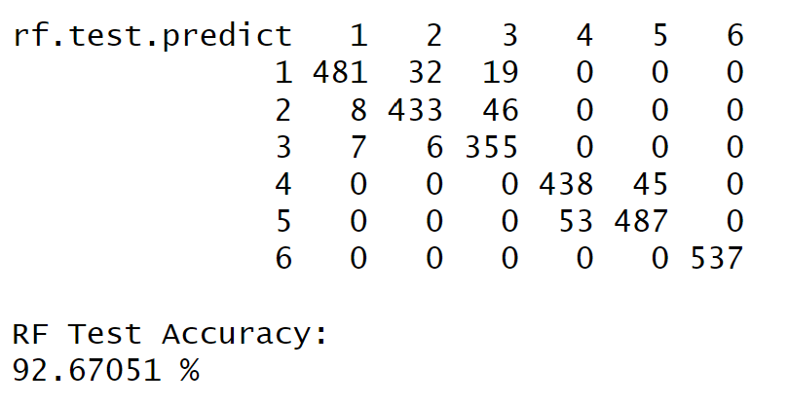
Random Forest Decision Tree
Random Forest adds additional randomness to combat the influence of prominent features on tree making
Under classification problems, number of features considered at each split by default is the square root of the number of features compared to one-third in regression problems [3]
EECS 6690 Final Project Presentation

Slide 19
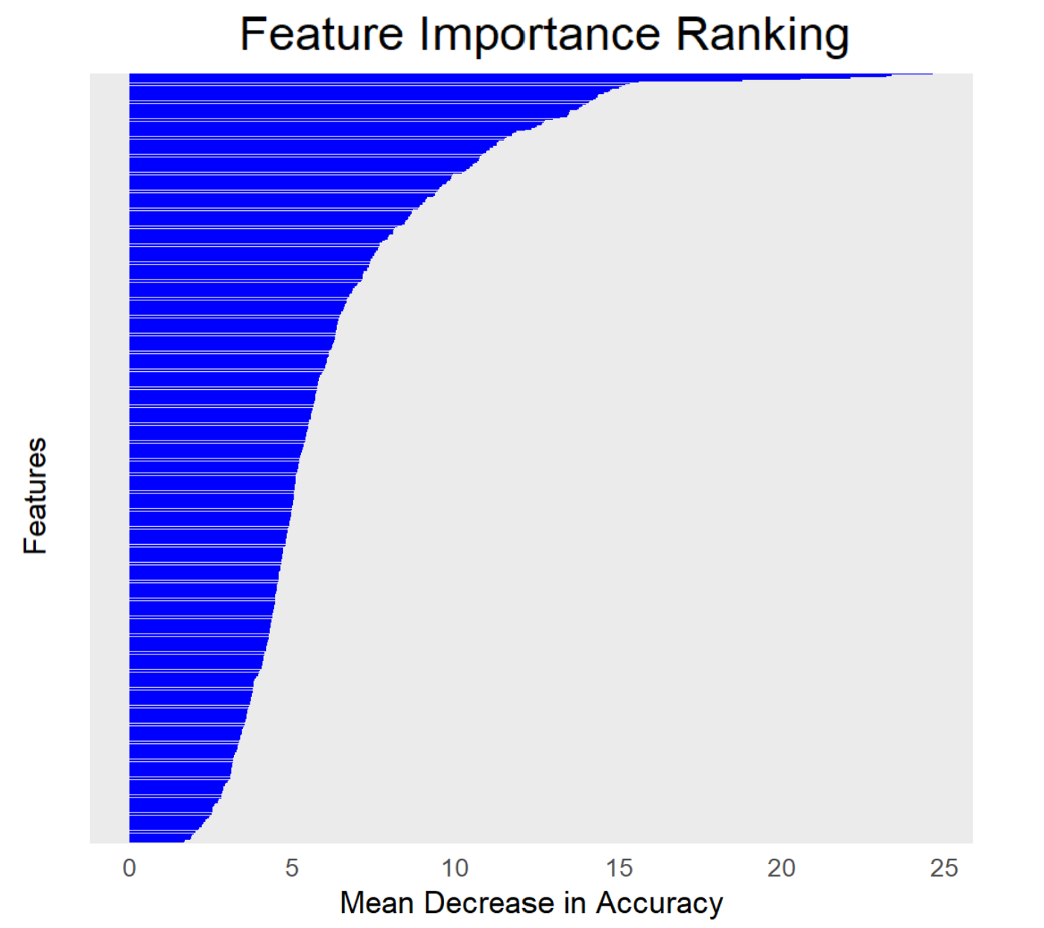
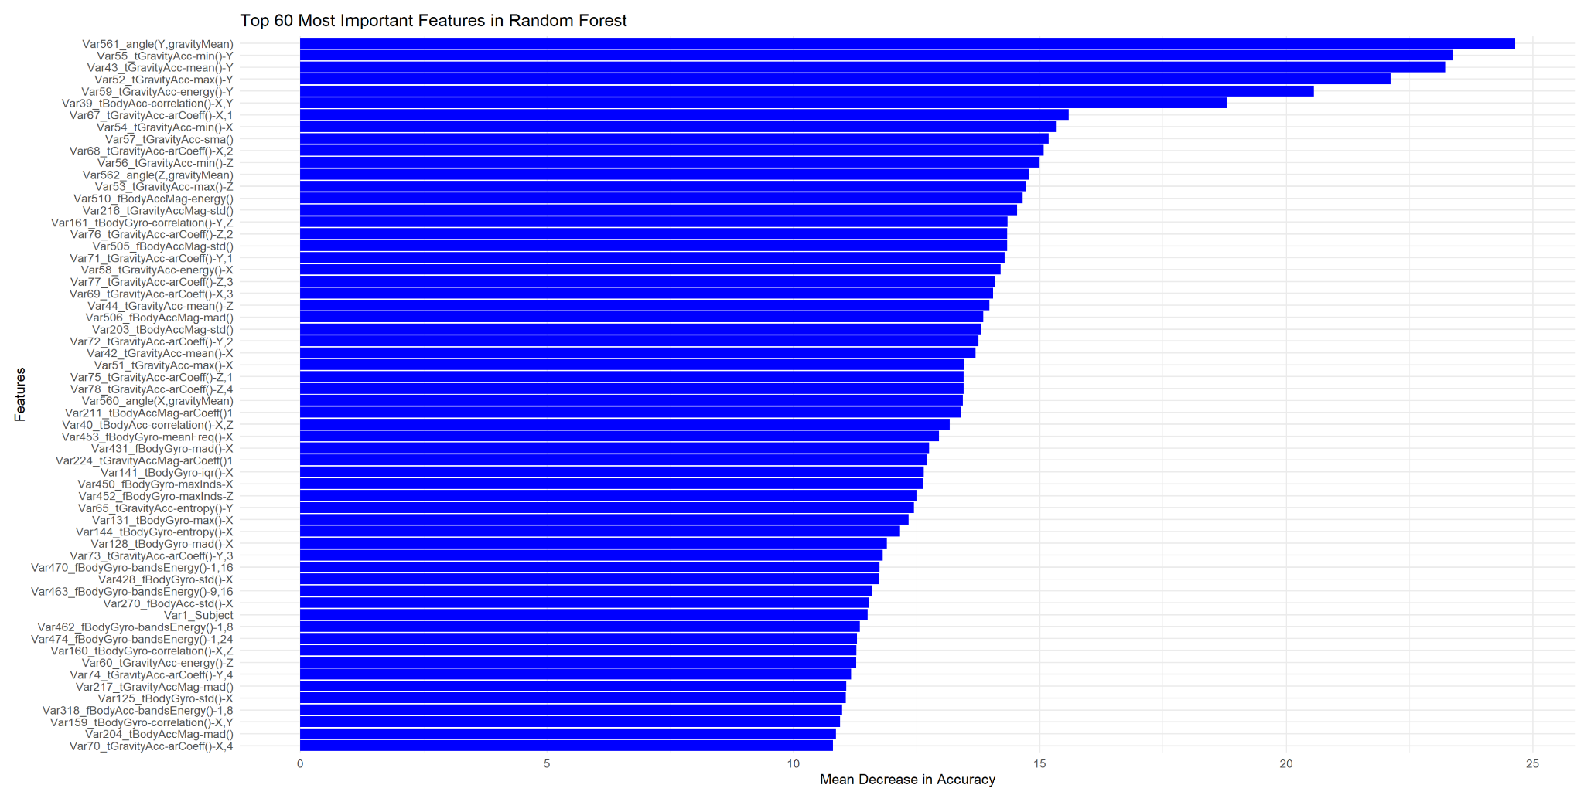
Insights from Random Forest Decision Tree
Dataset has dominant features that can affect previous decision tree accuracy
EECS 6690 Final Project Presentation

Slide 20
Insights from Random Forest Decision Tree
EECS 6690 Final Project Presentation

Slide 21
Conclusion
Successfully replicated the study produced by Anguita et al.
Created one-versus-all SVM model
Accurately able to distinguish one activity from the others
Implemented Decision tree models with comparable results
Better decision visualization
Effective method on non-linear data
Works well in a multi-classification setting
Future work:
Attempt to increase SVM or Boosting model above 96%
Dimension reduction to eliminate irrelevant data
Neural Networks
 | SVM Model | Single Decision Tree | Bagging | Random Forest | Generative Boosting
Overall Test Accuracy | 95.96% | 83.61% | 90.06% | 92.67% | 95.22%
EECS 6690 Final Project Presentation

Slide 22
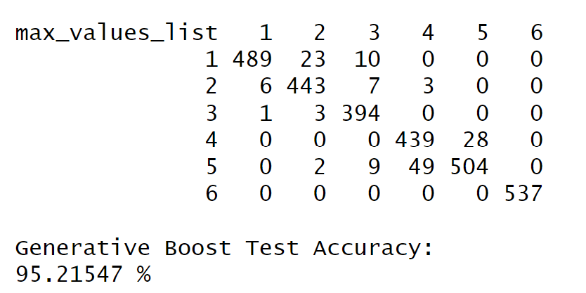
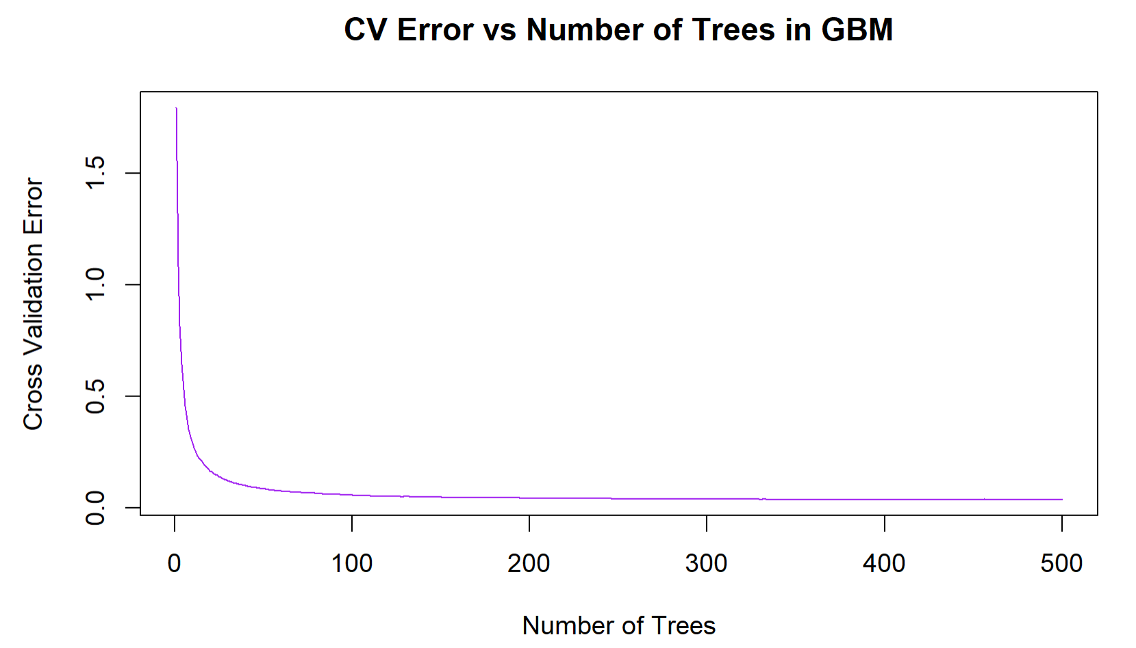
Boosting Decision Tree
Built using gbm() function following a similar process to that in ISL [3]
Requires two parameters:
B → Number of trees (used 500)
Shrinkage → Shrinkage factor (usually 0.001 or 0.01)
Started with a shrinkage of 0.01 (88.53%)
Following ISL suggestions shrinkage set to 0.2 (95.11%)
Resulted in large improvement of test accuracy
Continued with grid search and found shrinkage of 0.335 to give the best results
exploring shrinkage vs accuracy topology didn’t reveal any deeper error minima
EECS 6690 Final Project Presentation

Slide 23
References
[1] Davide Anguita, A. Ghio, L. Oneto, X. Parra, and J. L. Reyes-Ortiz, “A public domain dataset for human activity recognition using smartphones,” The European Symposium on Artificial Neural Networks, pp. 437–442, Jan. 2013.
[2] I. S. Al-Mejibli, J. K. Alwan, and D. H. Abd, “The effect of gamma value on support vector machine performance with different kernels,” International Journal of Electrical and Computer Engineering (IJECE), vol. 10, no. 5, p. 5497, Oct. 2020, doi: https://doi.org/10.11591/ijece.v10i5.pp5497-5506.
[3] G. James, D. Witten, T. Hastie, R. Tibshirani, and J. Taylor, An Introduction to Statistical Learning. Springer Nature, 2023. Available: https://www.statlearning.com/
‌
‌
EECS 6690 Final Project Presentation

